Slide 1
Graph Metrics

Slide 2
Graph Order and Size
The order of a graph is the cardinality of the vertex set (n)
1
2
3
4
7
5
6
8

Slide 3
Graph Order and Size
The order of a graph is the cardinality of the vertex set (n)
  This is the number of vertices:
    |V| = n = 8
1
2
3
4
7
5
6
8

Slide 4
Graph Order and Size
The order of a graph is the cardinality of the vertex set (n)
  This is the number of vertices:
    |V| = n = 8
1
2
3
4
7
The cardinality of a set is the number of elements inside it!
5
6
8

Slide 5
Graph Order and Size
The order of a graph is the cardinality of the vertex set (n)
  This is the number of vertices:
    |V| = n = 8
The size of a graph is the cardinality of the edge set (m)
1
2
3
4
7
5
6
8

Slide 6
Graph Order and Size
The order of a graph is the cardinality of the vertex set (n)
  This is the number of vertices:
    |V| = n = 8
The size of a graph is the cardinality of the edge set (m)
  This is the number of edges:
    |E| = m = 7
1
2
3
4
7
The cardinality of a set is the number of elements inside it!
5
6
8

Slide 7
Graph Degree Set and Degree Sequence
The graph degree set (k) is a vector containing the degree of each node in the graph
1
V₁ | V₂ | V₃ | V₄ | V₅ | V₆ | V₇ | V₈
2
3
4
7
5
6
8

Slide 8
Graph Degree Set and Degree Sequence
The graph degree set (k) is a vector containing the degree of each node in the graph
1
V₁ | V₂ | V₃ | V₄ | V₅ | V₆ | V₇ | V₈
1 | 2 | 4 | 2 | 2 | 0 | 2 | 1
2
3
4
7
5
6
8

Slide 9
Graph Degree Set and Degree Sequence
The graph degree set (k) is a vector containing the degree of each node in the graph
The graph degree sequence is an ordered version of the graph degree set
1
V₁ | V₂ | V₃ | V₄ | V₅ | V₆ | V₇ | V₈
1 | 2 | 4 | 2 | 2 | 0 | 2 | 1
2
3
4
7
5
6
8

Slide 10
Graph Degree Set and Degree Sequence
The graph degree set (k) is a vector containing the degree of each node in the graph
The graph degree sequence is an ordered version of the graph degree set
1
V₁ | V₂ | V₃ | V₄ | V₅ | V₆ | V₇ | V₈
1 | 2 | 4 | 2 | 2 | 0 | 2 | 1
2
3
4
7
5
6
8
4 | 2 | 2 | 2 | 2 | 1 | 1 | 0

Slide 11
Graph Maximum and Minimum Degree
The graph maximum degree (k_{max}) is the largest number in the graph degree set
1
V₁ | V₂ | V₃ | V₄ | V₅ | V₆ | V₇ | V₈
1 | 2 | 4 | 2 | 2 | 0 | 2 | 1
2
3
4
7
5
6
8

Slide 12
Graph Maximum and Minimum Degree
The graph maximum degree (k_{max}) is the largest number in the graph degree set
  k_{max} = 4
1
V₁ | V₂ | V₃ | V₄ | V₅ | V₆ | V₇ | V₈
1 | 2 | 4 | 2 | 2 | 0 | 2 | 1
2
3
4
7
5
6
8

Slide 13
Graph Maximum and Minimum Degree
The graph maximum degree (k_{max}) is the largest number in the graph degree set
  k_{max} = 4
The graph minimum degree (k_{min}) is the smallest number in the graph degree set
1
V₁ | V₂ | V₃ | V₄ | V₅ | V₆ | V₇ | V₈
1 | 2 | 4 | 2 | 2 | 0 | 2 | 1
2
3
4
7
5
6
8

Slide 14
Graph Maximum and Minimum Degree
The graph maximum degree (k_{max}) is the largest number in the graph degree set
  k_{max} = 4
The graph minimum degree (k_{min}) is the smallest number in the graph degree set
  k_{min}= 0
1
V₁ | V₂ | V₃ | V₄ | V₅ | V₆ | V₇ | V₈
1 | 2 | 4 | 2 | 2 | 0 | 2 | 1
2
3
4
7
5
6
8

Slide 15
Graph Maximum and Minimum Degree
The graph maximum degree (k_{max}) is the largest number in the graph degree set
  k_{max} = 4
The graph minimum degree (k_{min}) is the smallest number in the graph degree set
  k_{min}= 0
1
V₁ | V₂ | V₃ | V₄ | V₅ | V₆ | V₇ | V₈
1 | 2 | 4 | 2 | 2 | 0 | 2 | 1
2
3
4
7
5
6
8

Slide 16
Graph Degree Range
The graph degree range (k_{r}) is the difference between the maximum and minimum degrees
1
V₁ | V₂ | V₃ | V₄ | V₅ | V₆ | V₇ | V₈
1 | 2 | 4 | 2 | 2 | 0 | 2 | 1
2
3
4
7
5
6
8

Slide 17
Graph Degree Range
The graph degree range (k_{r}) is the difference between the maximum and minimum degrees
k_{r} = (k_{max}－ k_{min}) = (4 － 0) = 4
1
V₁ | V₂ | V₃ | V₄ | V₅ | V₆ | V₇ | V₈
1 | 2 | 4 | 2 | 2 | 0 | 2 | 1
2
3
4
7
5
6
8

Slide 18
Graph Sum of Degrees
The graph sum of degrees (Σk_{i}) is the sum of all the numbers in the graph degree set
1
V₁ | V₂ | V₃ | V₄ | V₅ | V₆ | V₇ | V₈
1 | 2 | 4 | 2 | 2 | 0 | 2 | 1
2
3
4
7
5
6
8

Slide 19
Graph Sum of Degrees
The graph sum of degrees (Σk_{i}) is the sum of all the numbers in the graph degree set
Σk_{i} = 1 + 2 + 4 + 2 + 2 + 0 + 2 + 1 = 14
1
V₁ | V₂ | V₃ | V₄ | V₅ | V₆ | V₇ | V₈
1 | 2 | 4 | 2 | 2 | 0 | 2 | 1
2
3
4
7
5
6
8

Slide 20
Graph Sum of Degrees
The graph sum of degrees (Σk_{i}) is the sum of all the numbers in the graph degree set
Σk_{i} = 1 + 2 + 4 + 2 + 2 + 0 + 2 + 1 = 14
  In an undirected graph the sum of degrees is equal to twice the number of edges!
    Σk_{i} = 2m = 2 ✕ 7 = 14
1
V₁ | V₂ | V₃ | V₄ | V₅ | V₆ | V₇ | V₈
1 | 2 | 4 | 2 | 2 | 0 | 2 | 1
2
3
4
7
5
6
8

Slide 21
Graph Average Degree
The graph average degree ( ) is the ratio of the sum of the degrees (Σk_{i}) to the graph order (n)
1
V₁ | V₂ | V₃ | V₄ | V₅ | V₆ | V₇ | V₈
1 | 2 | 4 | 2 | 2 | 0 | 2 | 1
2
3
4
7
5
6
8

Slide 22
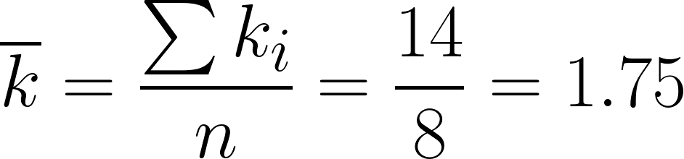
Graph Average Degree
The graph average degree ( ) is the ratio of the sum of the degrees (Σk_{i}) to the graph order (n)
1
V₁ | V₂ | V₃ | V₄ | V₅ | V₆ | V₇ | V₈
1 | 2 | 4 | 2 | 2 | 0 | 2 | 1
2
3
4
7
5
6
8

Slide 23
Graph Maximum Size
The maximum size of a graph of order n is the number of edges that would exist if graph was complete
1
2
3
4
7
5
6
8

Slide 24
Graph Maximum Size
The maximum size of a graph of order n is the number of edges that would exist if graph was complete
  How many total edges are there now?
1
2
3
4
7
This is a complete graph of order 8!
5
6
8

Slide 25

Graph Maximum Size
The maximum size of a graph of order n is the number of edges that would exist if graph was complete
  How many total edges are there now?
We can try to count and get a headache, or we can use math:
1
2
3
4
7
5
6
8

Slide 26
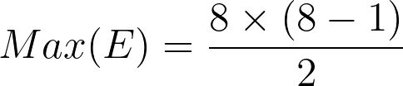
Graph Maximum Size
The maximum size of a graph of order n is the number of edges that would exist if graph was complete
  How many total edges are there now?
We can try to count and get a headache, or we can use math:
1
2
3
4
7
5
6
8

Slide 27
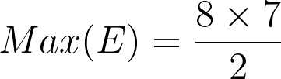
Graph Maximum Size
The maximum size of a graph of order n is the number of edges that would exist if graph was complete
  How many total edges are there now?
We can try to count and get a headache, or we can use math:
1
2
3
4
7
5
6
8

Slide 28
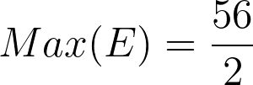
Graph Maximum Size
The maximum size of a graph of order n is the number of edges that would exist if graph was complete
  How many total edges are there now?
We can try to count and get a headache, or we can use math:
1
2
3
4
7
5
6
8

Slide 29

Graph Maximum Size
The maximum size of a graph of order n is the number of edges that would exist if graph was complete
  How many total edges are there now?
We can try to count and get a headache, or we can use math:
1
2
3
4
7
There are 28 edges in there!
5
6
8

Slide 30
Graph Density
We may be interested in how close (or far) a given graph is from its maximum
This called the density of the graph
1
2
3
4
7
5
6
8

Slide 31
Graph Density
We may be interested in how close (or far) a given graph is from its maximum
This called the density of the graph
  To find that out, we can compute the ratio between:
    The observed number of edges (m)
    And the maximum possible for a graph of that order (Max(E))
1
2
3
4
7
5
6
8

Slide 32
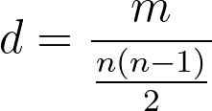
Graph Density
We may be interested in how close (or far) a given graph is from its maximum
This called the density of the graph
  To find that out, we can compute the ratio between:
    The observed number of edges (m)
    And the maximum possible for a graph of that order (Max(E))
1
2
3
4
7
5
6
8

Slide 33
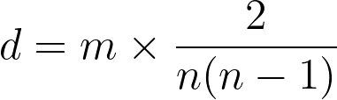
Graph Density
We may be interested in how close (or far) a given graph is from its maximum
This called the density of the graph
  To find that out, we can compute the ratio between:
    The observed number of edges (m)
    And the maximum possible for a graph of that order (Max(E))
1
2
3
4
7
5
6
8

Slide 34
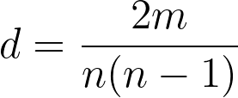
Graph Density
We may be interested in how close (or far) a given graph is from its maximum
This called the density of the graph
  To find that out, we can compute the ratio between:
    The observed number of edges (M)
    And the maximum possible for a graph of that order (Max(E))
1
2
3
4
7
5
6
8

Slide 35
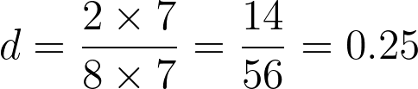
Graph Density
We may be interested in how close (or far) a given graph is from its maximum
This called the density of the graph
  To find that out, we can compute the ratio between:
    The observed number of edges (M)
    And the maximum possible for a graph of that order (Max(E))
1
2
3
4
7
5
6
8

Slide 36
Graph Density
We may be interested in how close (or far) a given graph is from its maximum
This called the density of the graph
  Density (d) is always a number between 0 and 1
    The closer d is to zero the closer the observed graph is to the empty graph
    The closer d is to one the closer the observed graph is to the complete graph
1
2
3
4
7
5
6
8

Slide 37
Graph Density
We may also be interested in how close (or far) a given graph is from its maximum
This called the density of the graph
  Density (d) is always a number between 0 and 1
    The closer d is to zero the closer the observed graph is to the empty graph
    The closer d is to one the closer the observed graph is to the complete graph
1
2
3
4
7
This graph has a density equal to one!
5
6
8

Slide 38
Graph Density
We may also be interested in how close (or far) a given graph is from its maximum
This called the density of the graph
  Density (d) is always a number between 0 and 1
    The closer d is to zero the closer the observed graph is to the empty graph
    The closer d is to one the closer the observed graph is to the complete graph
1
2
3
4
7
This graph has a density equal to zero!
5
6
8

Slide 39

Graph Density
We may also be interested in how close (or far) a given graph is from its maximum
This called the density of the graph
  The graph density can be interpreted in two other ways
    As the percentage of possible edges that are actually present
    As the probability that if we pick two nodes at random from the graph that there will be an edge linking them
1
2
3
4
7
5
6
8

